Slide 1
MODULE 1

Slide 2
What is a computer?
a computer is a sophisticated electronic calculating machine that:
Accepts input information,
Processes the information according to a list of internally stored instructions and
Produces the resulting output information.
Functions performed by a computer are:
Accepting information to be processed as input.
Storing a list of instructions to process the information.
Processing the information according to the list of instructions.
Providing the results of the processing as output.
What are the functional units of a computer?
2

Slide 3
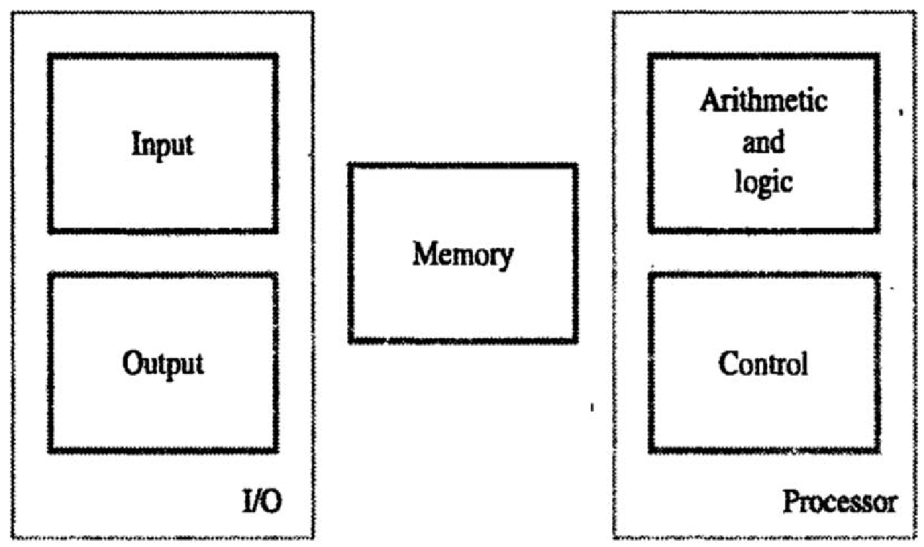
FUNCTIONAL UNITS:
The computer system is divided into five separate units for its operation.
Input Unit.
Memory Unit.
ALU.
Control Unit.
Output Unit.
The input unit accepts the code information from the users .The information received is either stored in the Memory or immediately used by the Arithmetic & Logic circuitry to form the desired operations .The processing steps are determined by the program stored in the memory. Finally the results are sent back to the outside world through the output unit. All these actions are coordinated by the control unit

Slide 4
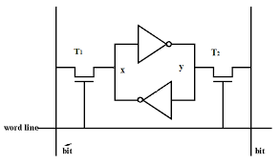
Input Unit.
Input units are used by the computer to read the data. The most commonly used input devices are keyboards, mouse, joysticks, trackballs, microphones, etc..
Most well known input device is the keyboard. Whenever a key is pressed, the corresponding letter or digit is automatically translated in to its binary code and transmitted through a cable either to memory or the processor
Memory Unit.
The function of the memory unit is to store programs and data.
There are two classes of storage, called primary and secondary.
Programs must be stored in memory while they are being executed.
Memory contains a large number of semiconductor storage cells, each capable of storing one bit of information.
These cells are rarely read or written as individual cell but instead are processed in groups of fixed size called word.
The memory is organized so that the contents of one word containing n bits can be stored and retrieved in one basic operation
To provide easy access to any word in memory, a distinct address is associated with each word location. Address are numbers that identify successive locations. A given is accessed by its address and issuing a control command that starts the storage or retrieval process

Slide 5
Arithmetic and logic unit
Most of all the arithmetic and logical operations of a computer are executed in the ALU (Arithmetic and Logical Unit) of the processor. It performs arithmetic operations like addition, subtraction, multiplication, division and also the logical operations like AND, OR, NOT operations.
Output Unit.
The primary function of the output unit is to send the processed results to the user. Output devices display information in a way that the user can understand.
Output devices are pieces of equipment that are used to generate information or any other response processed by the computer. These devices display information that has been held or generated within a computer.
The most common example of an output device is a monitor.
Control Unit.
Control unit controls and coordinates the entire operations of the computer system.
The control unit determines the sequence in which computer programs and instructions are executed.
Things like processing of programs stored in the main memory, interpretation of the instructions and issuing of signals for other units of the computer to execute them

Slide 6
The operation of a computer can be summarized as follows
The computer accepts information in the form of programs and data through an input and stores it in the memory
Information stored in the memory is fetched to the processor where it is processed
Processed information leaves the computer through an output unit
All activities inside the machine are directed by control unit

Slide 7
How are the functional units connected?
For a computer to achieve its operation, the functional units need to
communicate with each other.
In order to communicate, they need to be connected.
Input
Output
Memory
Processor
Bus
Functional units may be connected by a group of parallel wires.
The group of parallel wires is called a bus.
Each wire in a bus can transfer one bit of information.
The number of parallel wires in a bus is equal to the word length of
a computer
7
Notes:
7
What is a word? What is a word length? During the discussion of which functional unit did we come across this concept?

Slide 8
Organization of cache and main memory
Main Memory
Cache m/y
Processor
Bus
Why is the access time of the cache memory lesser than the
access time of the main memory?
8

Slide 9
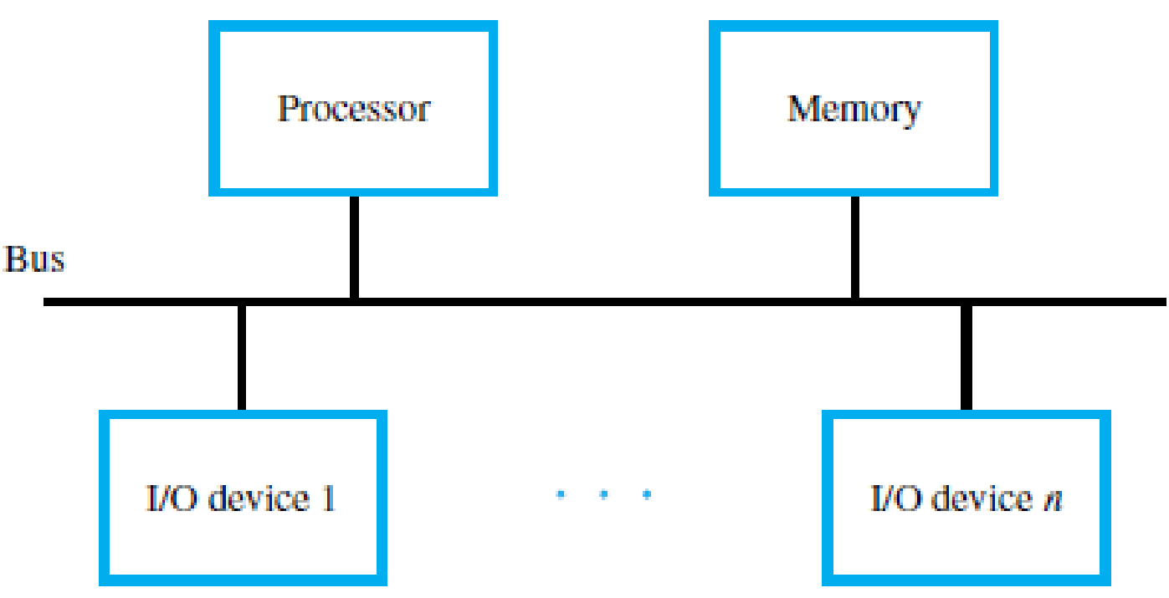
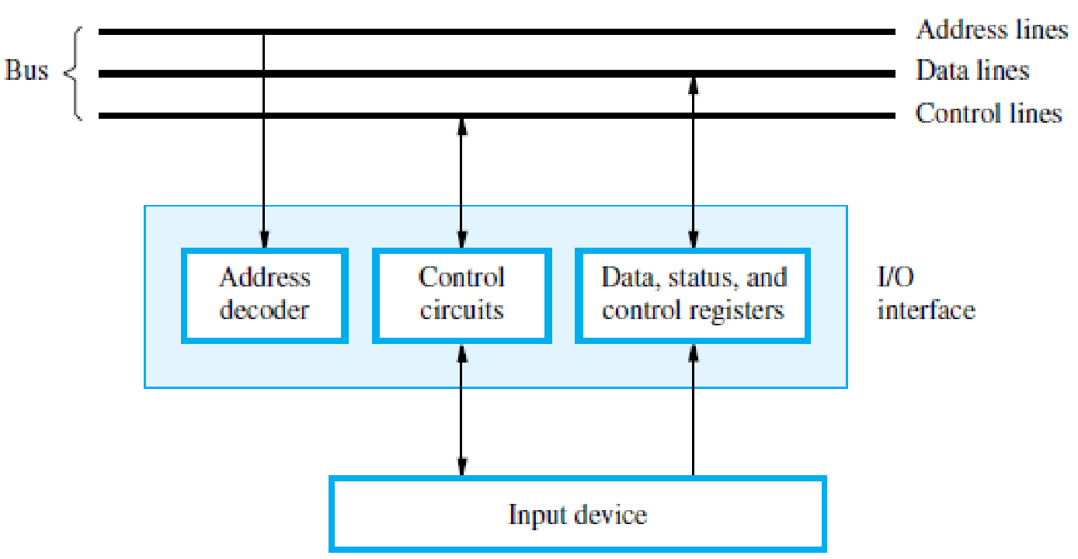
BUS STRUCTURES
A group of lines that serves as a connecting path for several devices is called a bus
The simplest way to interconnect functional units is to use a single bus (All the units are connected to this bus)
Only two units can actively use the bus at any given time
System that contain multiple bus allows two or more transfers to be carried out at the same time
When a word of data is transferred between units, all its bits are transferred in parallel ie the bits are transferred simultaneously over many wires or lines, one bit per line

Slide 10
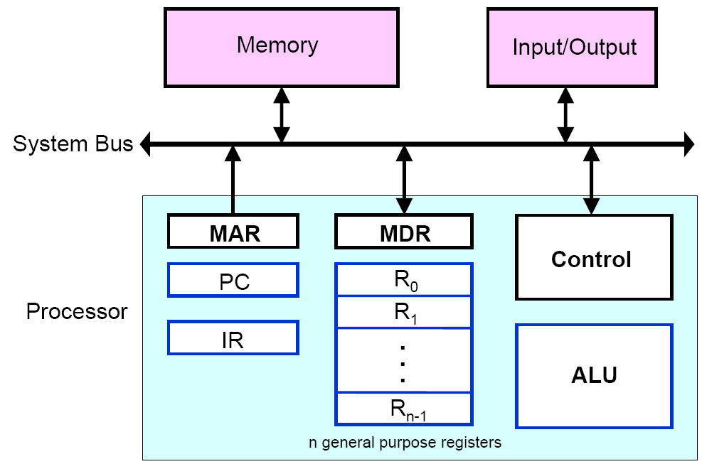
Computer Components: Top-Level View
Interconnection between Processor and Memory

Slide 11
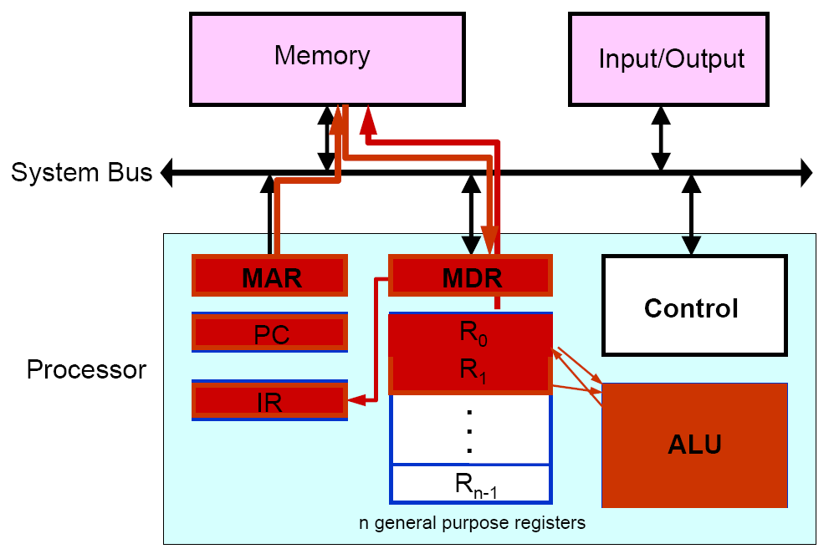
Basic Operational Concepts

Slide 12
Registers
Registers are fastest and alone storage locations that hold data temporarily. Multiple registers are needed to facilitate the operation of the CPU. Some of these registers are
􀂉Two registers-MAR (Memory Address Register) and MDR (Memory Data Register): To handle the data transfer between main memory and processor. MAR- Holds addresses, MDR-Holds data
􀂉Instruction register (IR): Hold the Instructions that is currently being executed.
􀂉Program counter (PC): Points to the next instructions that is to be fetched from memory.
12

Slide 13
(PC) (MAR) ( the contents of PC transferred to MAR)
(MAR) (Address bus) Select a particular memory location
Issues RD control signals
•Reads instruction present in memory and loaded into MDR
•Will be placed in IR (Contents transferred from MDR to IR)
13

Slide 14
•Instruction present in IR will be decoded by which processor understand what operation it has to perform
•Increments the contents of PC by 1, so that it points to the next instruction address
•If data required for operation is available in register, it performs the operation
•If data is present in memory following sequence is performed
14

Slide 15
•Address of the data MAR
•MAR Address bus select memory location where is issued RD signal
•Reads data via data bus MDR
•From MDR data can be directly routed to ALU or it can be placed in register and then operation can be performed
•Results of the operation can be directed towards output device, memory or register
•Normal execution preempted (interrupt)
15

Slide 16
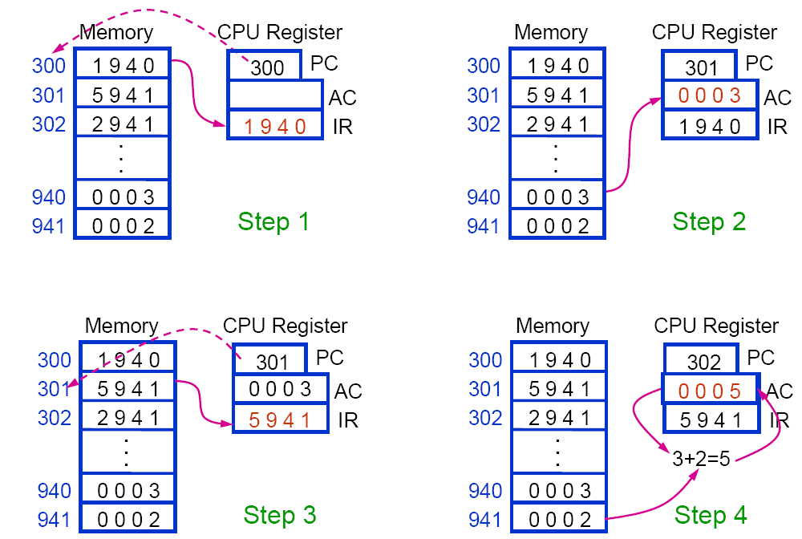
A Partial Program Execution Example
Notes:
1 --🡪load
5--🡪 add
2---🡪store
16

Slide 17
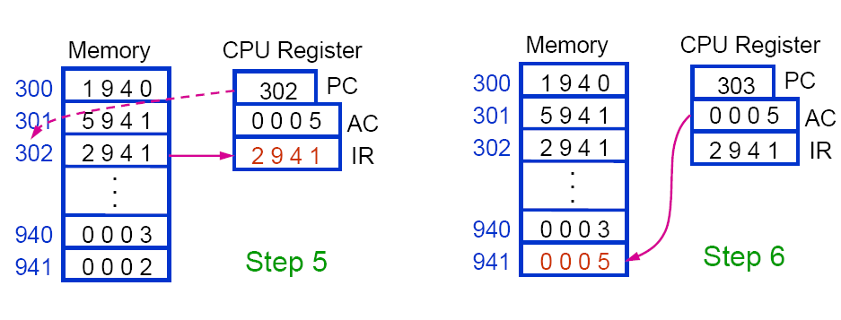
A Partial Program Execution Example

Slide 18
MEMORY LOCATIONS AND ADDRESSES
The memory consists of many millions of storage cells, each of which can store a bit of information having the value 0 or 1.
The memory is organized so that a group of n bits can be stored or retrieved in a single, basic operation.
Each group of n bits is referred to as a word of information, and n is called the word length
A unit of 8 bits is called a byte.
Machine instructions may require one or more words for their representation.
Accessing the memory to store or retrieve a single item of information, either a word or a byte, requires distinct names or addresses for each location.
The memory can have up to 2^{k} addressable locations. The 2^{k} addresses constitute the address space of the computer

Slide 19
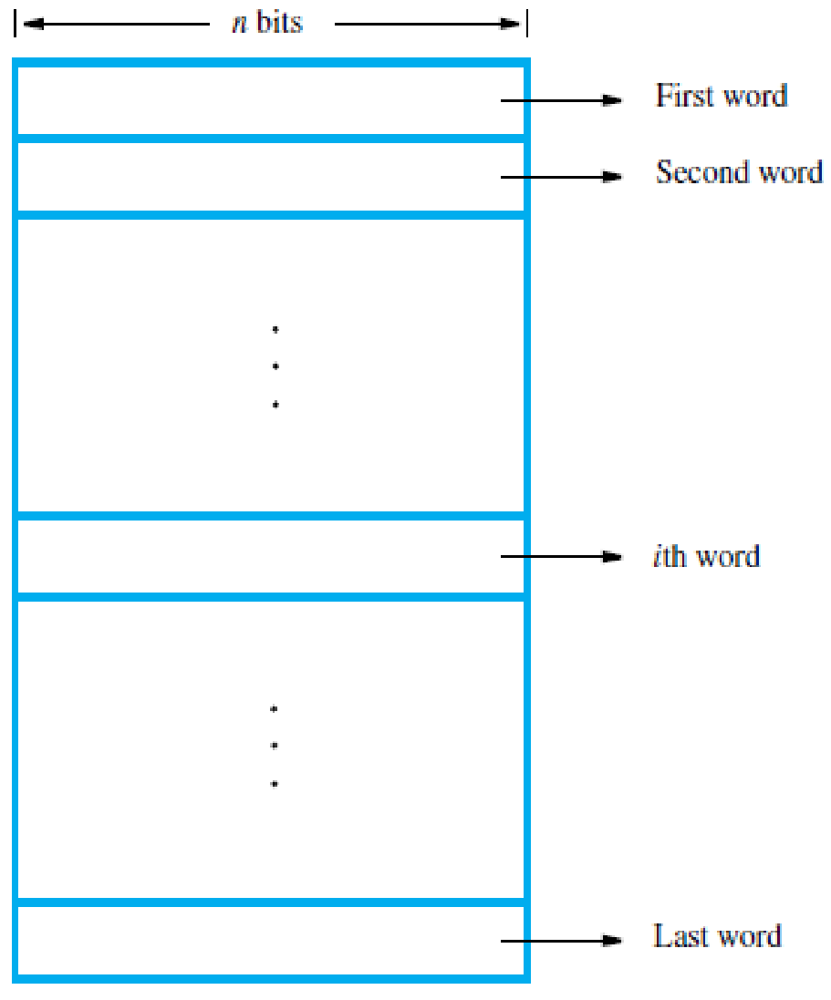
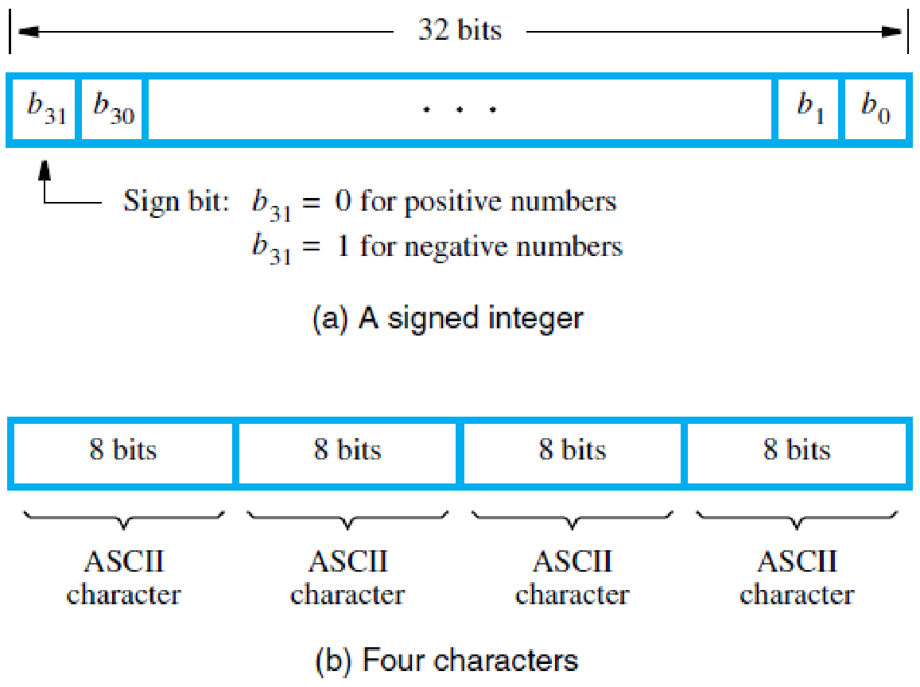
Byte Addressability
We now have three basic information quantities to deal with: bit, byte, and word.
A byte is always 8 bits, but the word length typically ranges from 16 to 64 bits.
It is impractical to assign distinct addresses to individual bit locations in the memory. The most practical assignment is to have successive addresses refer to successive byte locations in the memory.
The term byte-addressable memory is used for this assignment. Byte locations have addresses 0, 1, 2 . . . Thus, if the word length of the machine is 32 bits, successive words are located at addresses 0, 4, 8… with each word consisting of four bytes.

Slide 20
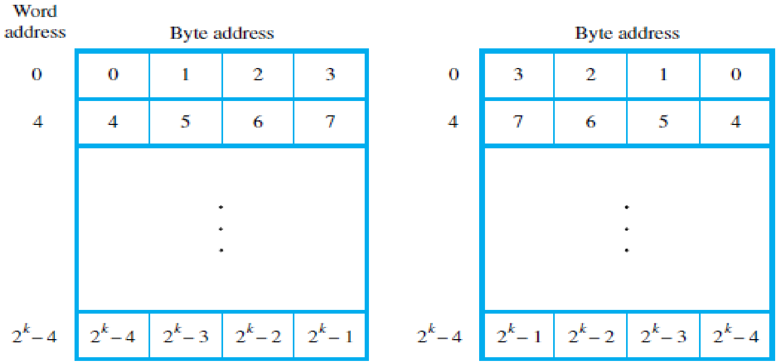
Big-Endian and Little-Endian Assignments
There are two ways that byte addresses can be assigned across words.
The name big-endian is used when lower byte addresses are used for the more significant bytes (the leftmost bytes) of the word.
The name little-endian is used for the opposite ordering, where the lower byte addresses are used for the less significant bytes (the rightmost bytes) of the word.

Slide 21
Word Alignment
In the case of a 32-bit word length, natural word boundaries occur at addresses 0, 4, 8…
We say that the word locations have aligned addresses if they begin at a byte address that is a multiple of the number of bytes in a word.
For practical reasons associated with manipulating binary-coded addresses, the number of bytes in a word is a power of 2.
Hence, if the word length is 16 (2 bytes), aligned words begin at byte addresses 0, 2, 4... and for a word length of 64 (8 bytes), aligned words begin at byte addresses 0, 8, 16…
MEMORY OPERATIONS
Both program instructions and data operands are stored in the memory.
Two basic operations involving the memory are needed, namely, Read and Write.
The Read operation transfers a copy of the contents of a specific memory location to the processor. The memory contents remain unchanged.
To start a Read operation, the processor sends the address of the desired location to the memory and requests that its contents be read.
The memory reads the data stored at that address and sends them to the processor

Slide 22
The Write operation transfers an item of information from the processor to a specific memory location, overwriting the former contents of that location.
To initiate a Write operation, the processor sends the address of the desired location to the memory, together with the data to be written into that location.
The memory then uses the address and data to perform the write.

Slide 23
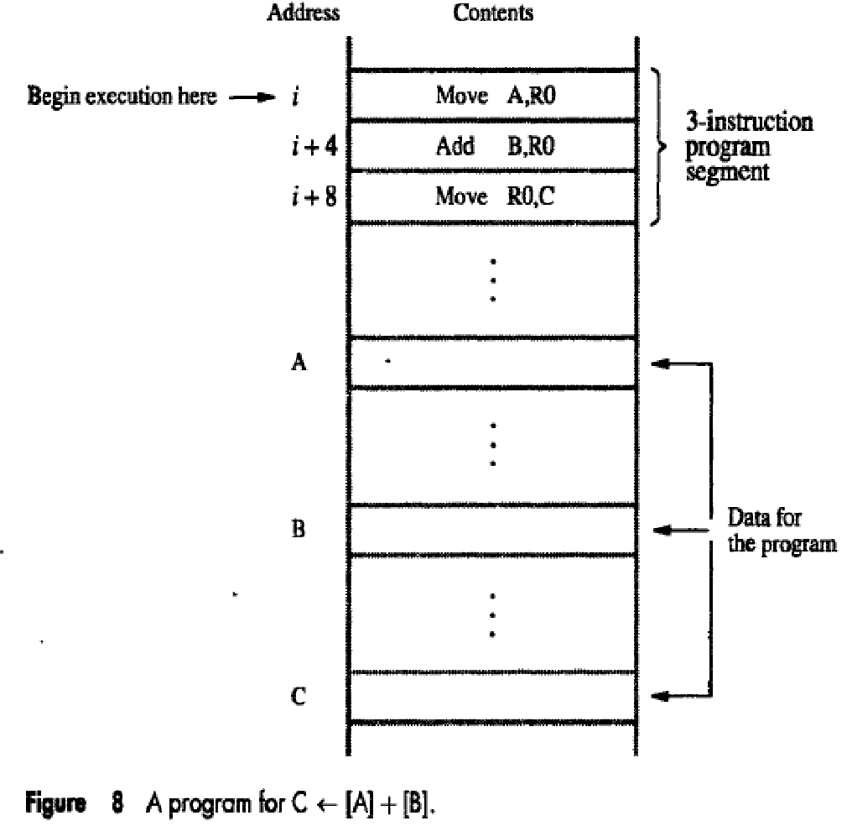
Instruction Execution and Straight-Line Sequencing
Let’s consider task C = A + B, implemented as C←[A] + [B].
Figure shows a possible program segment for this task as it appears in the memory of a computer.
We assume that the word length is 32 bits and the memory is byte-addressable.
The three instructions of the program are in successive word locations, starting at location i. Since each instruction is 4 bytes long, the second and third instructions are at addresses i + 4 and i + 8.
Let us consider how this program is executed.
To begin executing a program, the address of its first instruction (i in our example) must be placed into the PC.
Then, the processor control circuits use the information in the PC to fetch and execute instructions, one at a time, in the order of increasing addresses. This is called straight-line sequencing.
During the execution of each instruction, the PC is incremented by 4 to point to the next instruction. Thus, after the Move instruction at location i + 8 is executed, the PC contains the value i + 12

Slide 24
Executing a given instruction is a two-phase procedure.
In the first phase, called instruction fetch, the instruction is fetched from the memory location whose address is in the PC. This instruction is placed in the instruction register (IR) in the processor.
At the start of the second phase, called instruction decode & execute, the instruction in IR is examined to determine which operation is to be performed.
The specified operation is then performed by the processor.
Branching
We now introduce branch instructions.
This type of instruction loads a new address into the program counter.
As a result, the processor fetches and executes the instruction at this new address, called the branch target, instead of the instruction at the location that follows the branch instruction in sequential address order.
A conditional branch instruction causes a branch only if a specified condition is satisfied.
If the condition is not satisfied, the PC is incremented in the normal way, and the next instruction in sequential address order is fetched and executed.

Slide 25
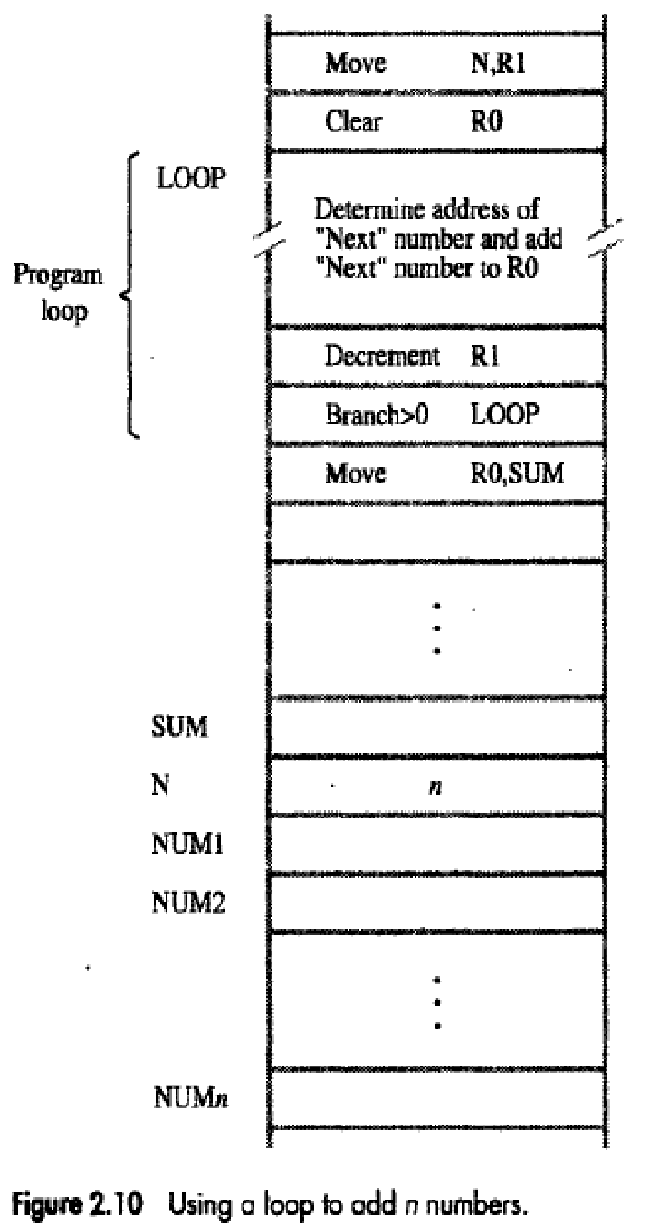
Consider the task of adding a list of n numbers.
LOOP is a straight line sequence of instructions executed as many times as needed.
Assume that the number of entries in the list, n, is stored in memory location N.
Register R1 is used as a counter to determine the number of times the loop is executed.
Hence, the contents of location N are loaded into register R1 at the beginning of the program.
Then, within the body of the loop, the instruction Decrement R1 reduces the contents of R1 by 1 each time through the loop.
Execution of the loop is repeated as long as the content of R1 is greater than zero.

Slide 26
Branch>0 LOOP is same is a conditional branch instruction that causes a branch to location LOOP if the contents of register R1 are greater than zero.
This means that the loop is executed as long as there are entries in the list that are yet to be added to R0.
At the end of the nth pass through the loop, the Decrement instruction produces a zero and hence branching does not occur.
Move instruction is fetched and executed. It moves the final result from R0 into memory location SUM.

Slide 27
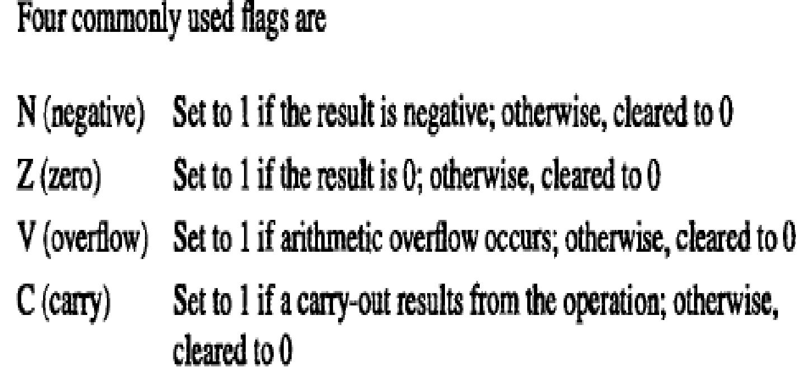
Condition Codes
The processor keeps track of instruction about the results of various operations for use by subsequent conditional branch instructions.
This is accomplished by recording the required information in individual bits often called as conditional code flags.
These flags are usually grouped together in a special processor register called the condition code register or status register.
Individual condition codes are set to 1 or cleared to 0, depending upon the outcome of the operation performed.

Slide 28
ADDRESSING MODES
The different ways for specifying the locations of operands are known as addressing modes.
Immediate mode:
The operand is given explicitly in the instruction.
Example: The instruction Add #200, R1, R2 adds the value 200 to the contents of register R1, and places the result into register R2. A common convention is to use the number sign (#) in front of the value to indicate that this value is to be used as an immediate operand.
Register mode:
The operand is the contents of a processor register; the name (address) of the register is given in the instruction. Example: The instruction Add R1, R2, R3 uses the Register mode for all three operands. Registers R1 and R2 hold the two source operands, while R3 is the destination.
Absolute/Direct mode:
The operand is in a memory location; the address of this location is given explicitly in the instruction.
Example: The Absolute mode is used in the instruction Move LOC, R1 which copies the value in the memory location LOC into register R1.

Slide 29
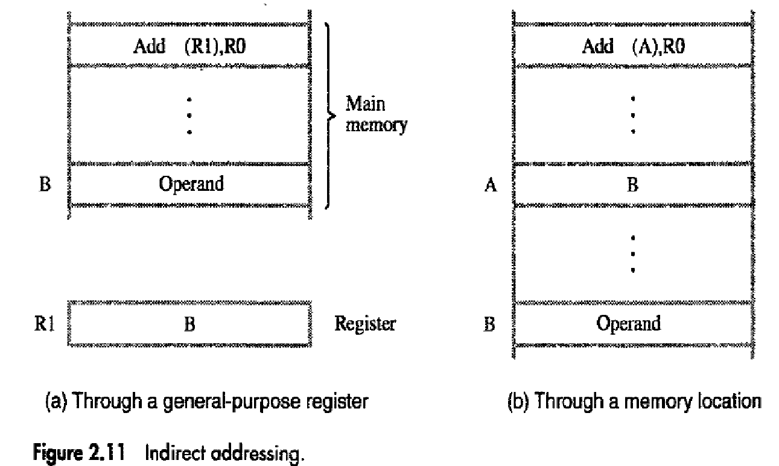
Indirect mode:
The effective address of the operand is the contents of a register or memory location whose address appears in the instruction. We denote indirection by placing the name of the register given in the instruction in parentheses ().

Slide 30
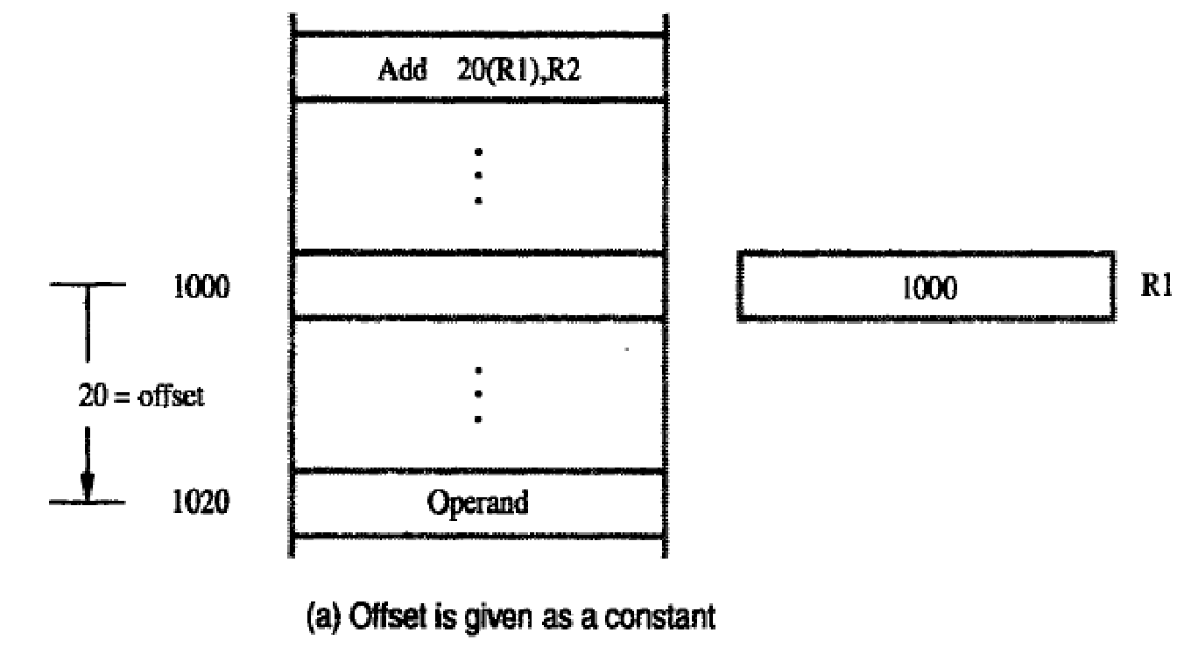
Index mode:
The effective address of the operand is generated by adding a constant value to the contents of a register.
The register used in this mode is referred as the index register.
We indicate the Index mode symbolically as X(Ri) where X denotes a constant signed integer value contained in the instruction and Ri is the name of the register involved.
The effective address of the operand is given by EA = X + [Ri]. The contents of index register are not changed in the process of generating the effective address.

Slide 31
Base with index:
A second register may be used to contain the offset X, in which case the index mode is written as, (Ri,Rj). The effective address is the sum of the contents of register Ri and Rj.
The second register is called as base register.
Base with index and offset:
Uses two registers plus a constant denoted as X(Ri,Rj). The effective address is the sum of the constant X and the contents of register Ri and Rj.
Relative Addressing
In index addressing, if the program counter PC, is used instead of a general-purpose register then X(PC) can be used to address a memory location that is X bytes away from the location presently pointed to by the program counter.
Since the addressed location is identified "relative" to the program counter, which always identifies the current execution point in a program, the name Relative mode is associated with this type of addressing.
Auto-increment mode:
The effective address of the operand is the contents of a register specified in the instruction. After accessing the operand, the contents of this register are automatically incremented to point to the next item in a list.
We denote the Auto-increment mode by putting the specified register in parentheses, to show that the contents of the register are used as the effective address, followed by a plus sign to indicate that these contents are to be incremented after the operand is accessed. Thus, the Auto-increment mode is written as (Ri)+

Slide 32
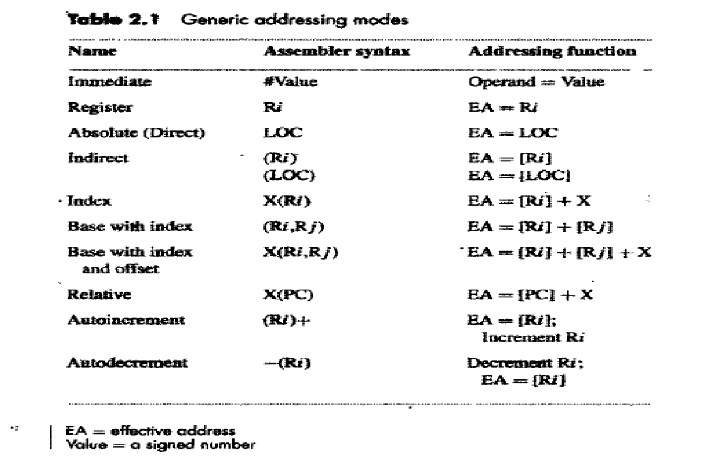
Auto-decrement mode:
The contents of a register specified in the instruction are first automatically decremented and are then used as the effective address of the operand. The Auto-increment mode is written as -(Ri)

Slide 33
BASIC PROCESSING UNIT - SOME FUNDAMENTAL CONCEPT
To execute a program, the processor fetches one instruction at a time and performs the operations specified.
Instructions are fetched from successive memory locations until a branch or a jump instruction is encountered.
The processor keeps track of the address of the memory location containing the next instruction to be fetched using the program counter, PC.
After fetching an instruction, the contents of the PC are updated to point to the next instruction in the sequence.
A branch instruction may load a different value into the PC. Another key register in the processor is the instruction register, IR
Suppose that each instruction comprises 4 bytes, and that it is stored in one memory word. To execute an instruction, the processor has to perform the following three steps:

Slide 34
Fetch the contents of the memory location pointed to by the PC. The contents of this location are the instruction to be executed; hence they are loaded into the IR. In register transfer notation, the required action is IR←[[PC]]
Increment the PC to point to the next instruction. Assuming that the memory is byte addressable, the PC is incremented by 4; that is PC←[PC] + 4
Carry out the operation specified by the instruction in the IR. Fetching an instruction and loading it into the IR is usually referred to as the instruction fetch phase. Performing the operation specified in the instruction constitutes the instruction execution phase.

Slide 35
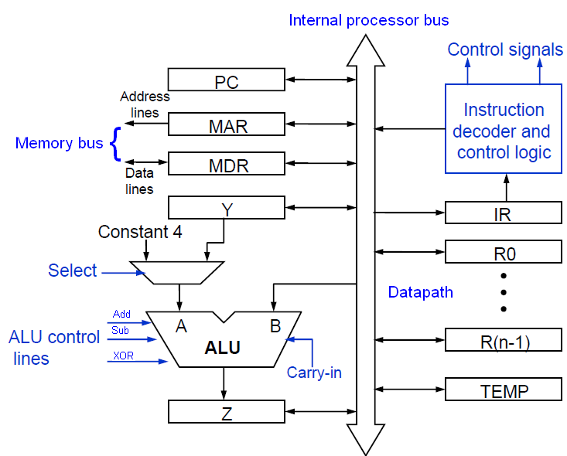
Internal organization of Processor
Datapath

Slide 36
Single Bus organization of Processor
Figure shows the organization in which the arithmetic and logic unit (ALU) and all the registers are interconnected via a single common bus
The data and address lines of the external memory bus are connected to the internal processor bus via the memory data register, MDR, and the memory address register, MAR, respectively.
Register MDR has two inputs and two outputs. Data may be loaded into MDR either from the memory bus or from the internal processor bus
The data stored in MDR may be placed on either bus. The input of MAR is connected to the internal bus, and its output is connected to the external bus. The control lines of the memory bus are connected to the instruction decoder and control logic block.
Three registers Y, Z, and TEMP registers are used by the processor for temporary storage during execution of some instructions.
The multiplexer MUX selects either the output of register Y or a constant value 4 to be provided as input A of the ALU. The constant 4 is used to increment the contents of the program counter

Slide 37
With few exceptions, an instruction can be executed by performing one or more of the following operations in some specified sequence:
Transfer a word of data from one processor register to another or to the ALU
Perform an arithmetic or a logic operation and store the result in a processor register
Fetch the contents of a given memory location and load them into a processor register
Store a word of data from a processor register into a given memory location

Slide 38
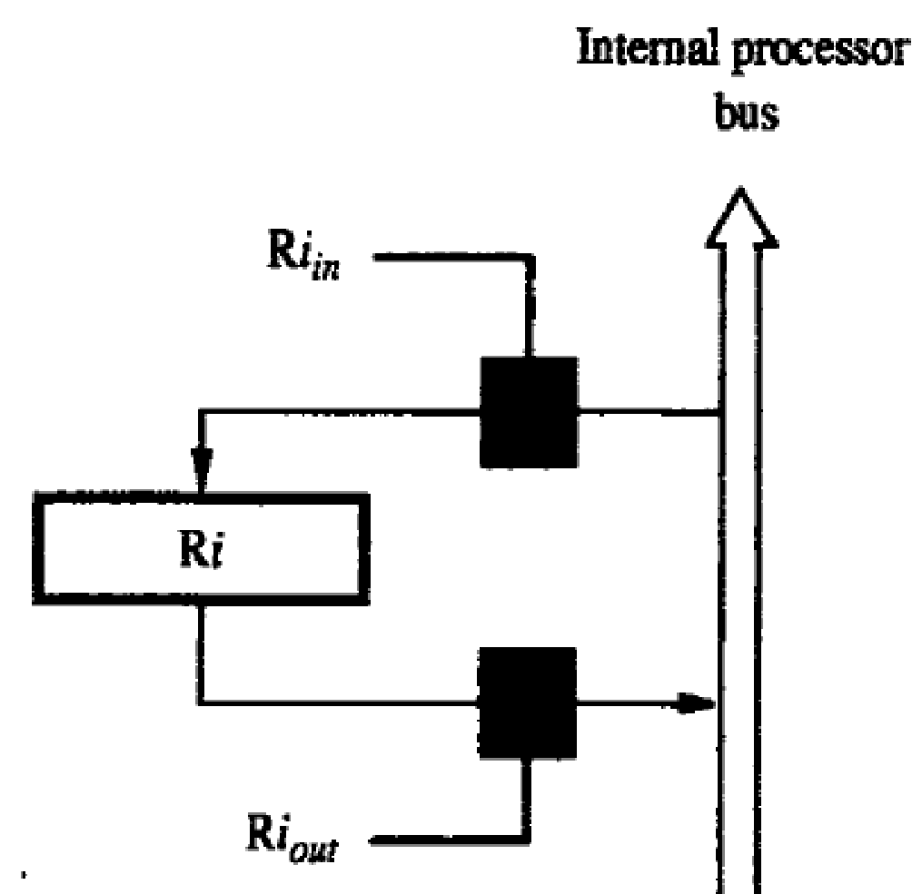
Register Transfers
Instruction execution involves a sequence of steps in which data are transferred from one register to another.
For each register, two control signals are used to place the contents of that register on the bus or to load the data on the bus into the register.
The input and output of register Ri are connected to the bus via switches controlled by the signals Ri_{in} and Ri _{out}, respectively.
When Ri _{in} is set to 1, the data on the bus are loaded into Ri. Similarly, when Ri _{out}, is set to 1, the contents of register Ri are placed on the bus.
While Ri _{out} is equal to 0, the bus can be used for transferring data from other registers.

Slide 39
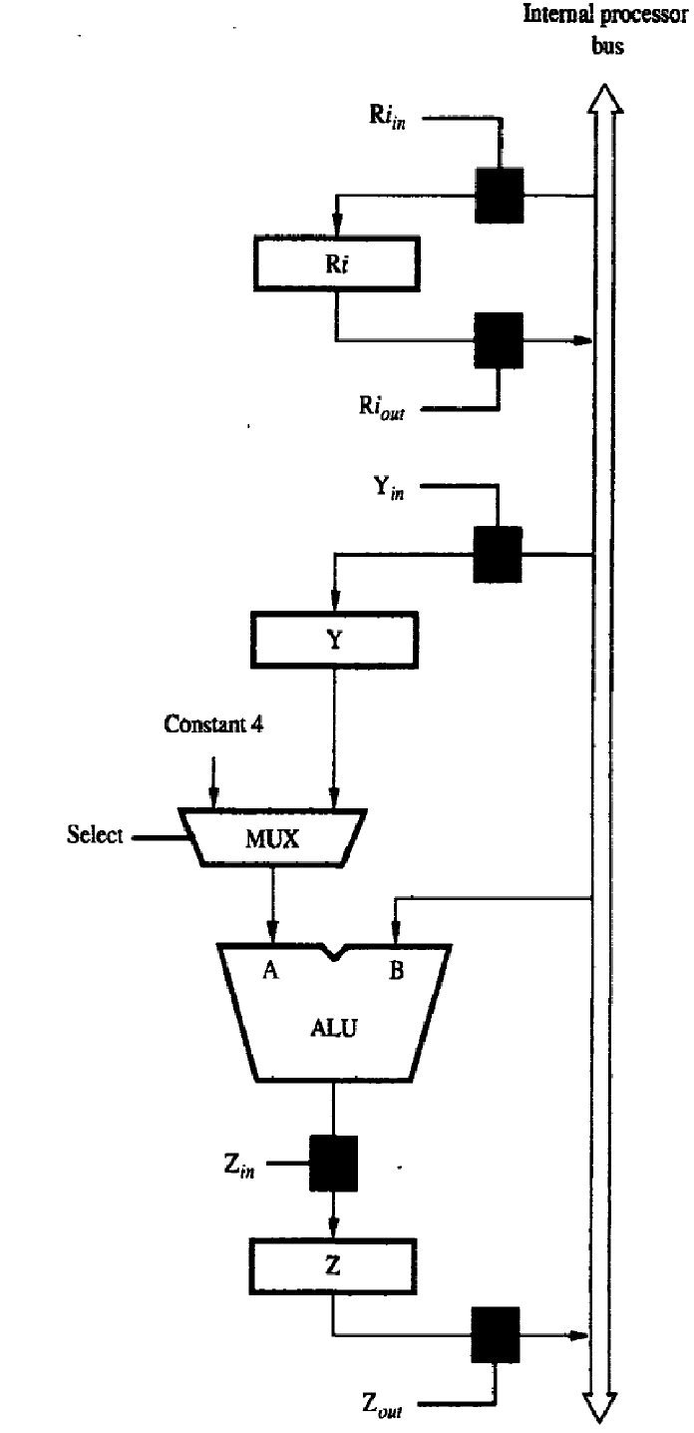
Performing an Arithmetic or Logic Operation
a sequence of operations to add the contents of register R1 to those of register R2 and store the result in register R3 is
1. R1out, Yin
2. R2out, Select Y, Add, Zin
3. Zout R3in

Slide 40
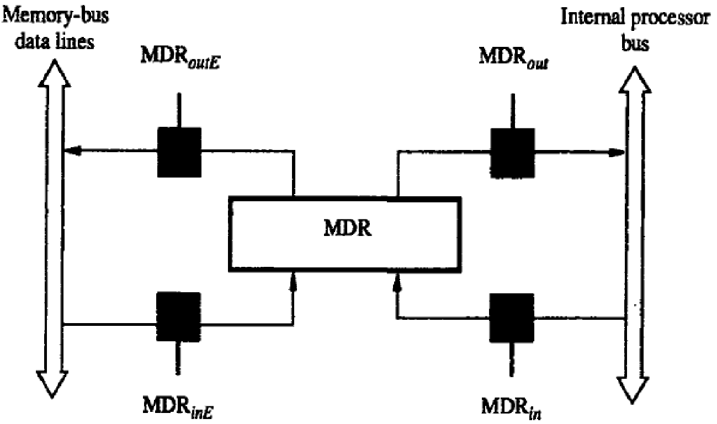
Fetching a Word from Memory
To fetch a word of information from memory, the processor has to specify the address of the memory location where this information is stored and request a Read operation.
It has four control signals: MDRin and MDRout, control the connection to the internal bus, and MDRinE and MDRoutE control the connection to the external bus

Slide 41
As an example of a read operation, consider the instruction Move (R1),R2. The actions needed to execute this instruction are:
1. MAR [RI]
2. Start a Read operation on the memory bus
3. Wait for the MFC(Memory Function Completed) response from the memory
4. Load MDR from the memory bus
5. R2 [MDR]

Slide 42
The memory read operation requires three steps, which can be described by the signals being activated as follows:
1. Rlout, MARin, Read
2. MDRinE, WMFC
3. MDRout, R2in
where WMFC is the control signal that causes the processor's control circuitry to wait for the arrival of the MFC signal

Slide 43
Storing a word in Memory
Writing a word into a memory location follows a similar procedure.
The desired address is loaded into MAR. Then, the data to be written are loaded into MDR, and a Write command is issued. Hence, executing the instruction Move R2,(R1) requires the following sequence:
1. R1out, MARin
2. R2out, MDRin, Write
3. MDRoutE, WMFC

Slide 44
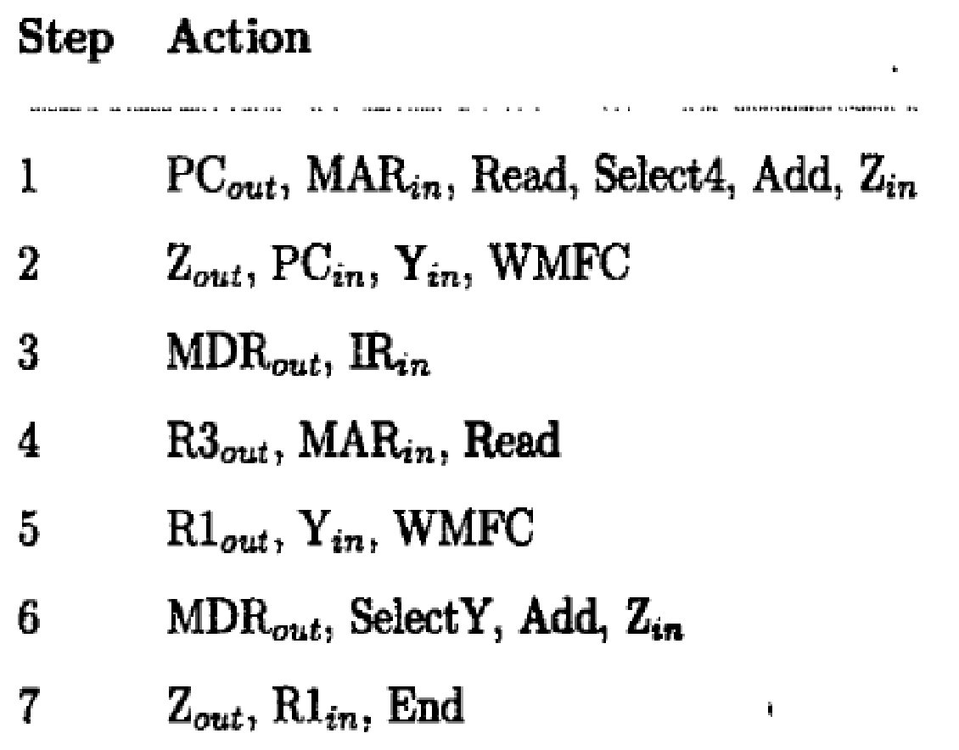
EXECUTION OF A COMPLETE INSTRUCTION
Consider the instruction Add (R3),R1 which adds the contents of a memory location pointed to by R3 to register R 1. Executing this instruction requires the following actions:
1. Fetch the instruction.
2. Fetch the first operand (the contents of the memory location pointed to by R3).
3. Perform the addition.
4. Load the result into RI.
Instruction execution proceeds as follows

Slide 45
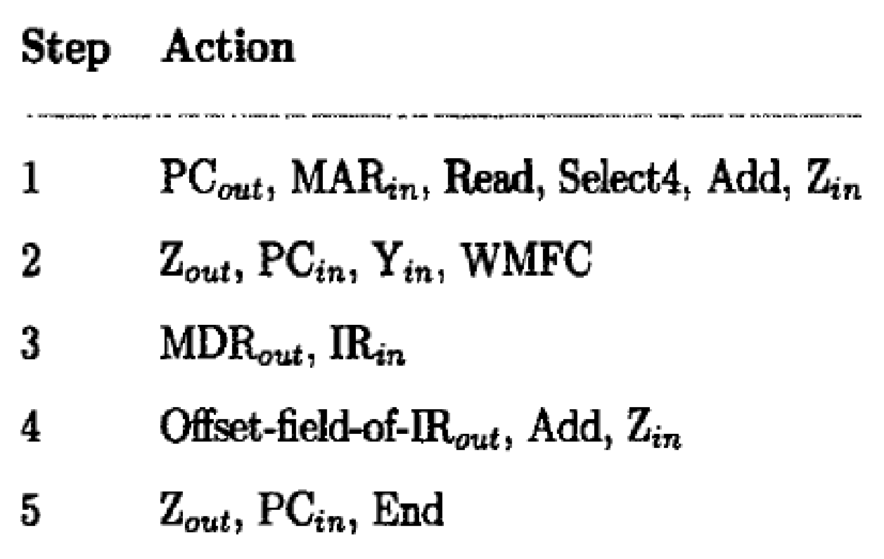
Branch Instruction
A branch instruction replaces the contents of the PC with the branch target address.
This address is usually obtained by adding an offset X, which is given in the branch instruction, to the updated value of the PC. Figure gives a control sequence that implements an unconditional branch instruction.
Processing starts, as usual, with the fetch phase. This phase ends when the instruction is loaded into the IR in step 3.
The offset value is extracted from the IR by the instruction decoding circuit, which will also perform sign extension if required.
Since the value of the updated PC is already available in register Y, the offset X is gated onto the bus in step 4, and an addition operation is performed. The result, which is the branch target address, is loaded into the PC in step 5.

Slide 46
MULTIPLE BUS ORGANIZATION
In single-bus structure only one data item can be transferred over the bus in a clock cycle.
To reduce the number of steps needed, most commercial processors provide multiple internal paths that enable several transfers to take place in parallel.
Figure depicts a three-bus structure used to connect the registers and the ALU of a processor.
The register file is said to have three ports. There are two outputs, allowing the contents of two different registers to be accessed simultaneously and have their contents placed on buses A and B.
The third port allows the data on bus C to be loaded into a third register during the same clock cycle.

Slide 47
Buses A and B are used to transfer the source operands to the A and B inputs of the ALU, where an arithmetic or logic operation may be performed. The result is transferred to the destination over bus C.
If needed, the ALU may simply pass one of its two input operands unmodified to bus C. We will call the ALU control signals for such an operation R=A or R=B. The three-bus arrangement obviates the need for registers Y and Z.

Slide 48
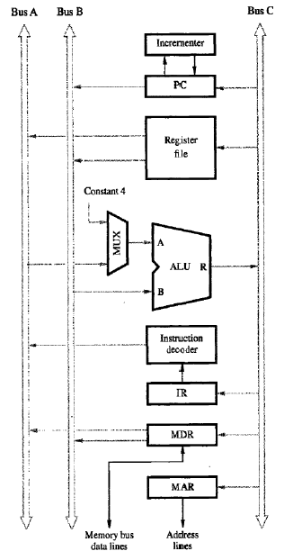
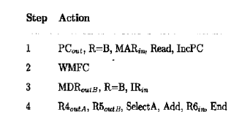

Slide 49
A second feature is the introduction of the Incrementer unit, which is used to increment the PC by 4.
Using the Incrementer eliminates the need to add 4 to the PC using the main ALU. The source for the constant 4 at the ALU input multiplexer is still useful.
Consider the three-operand instruction
Add R4,R5,R6
The control sequence for executing this instruction is given as below

Slide 50
Step 1: the contents of the PC are passed through the ALU, using the R=B control signal, and loaded into the MAR to start a memory read operation. At the same time the PC is incremented by 4. Note that the value loaded into MAR is the original contents of the PC. The incremented value is loaded into the PC at the end of the clock cycle and will not affect the contents of MAR.

Slide 51
Step 2: the processor waits for MFC and loads the data received into MDR.
Step 3: Transfers the data received in MDR to IR.
Step 4: The execution phase of the instruction requires only one control step to complete. By providing more paths for data transfer a significant reduction in the number of clock cycles needed to execute an instruction is achieved.

